Slide 1
Lecture: 3 Demand And Supply (refer to Chapter 3 Parkin, Powell Book)
that a market is any arrangement that enables buyers and sellers to get information and to do business with each other.
Markets exist for all types of goods and services, such as currency exchange, shoes, saloons etc
competitive market – a market that has many buyers and many sellers, so no single buyer or seller can influence the price.
Producers offer items for sale only if the price is high enough to cover their opportunity cost. And consumers respond to changing opportunity cost by seeking cheaper alternatives to expensive items.

Slide 2
What is Demand?
If you demand something, then you
Want it,
Can afford it, and
Plan to buy it.
The quantity demanded of a good or service is the amount that consumers plan to buy during a given time period at a particular price. The quantity demanded is not necessarily the same as the quantity actually bought. Sometimes the quantity demanded exceeds the amount of goods available, so the quantity bought is less than the quantity demanded.

Slide 3
The Law of Demand
The law of demand states:
Other things remaining the same, the higher the price of a good, the smaller is the quantity demanded; and the lower the price of a good, the greater is the quantity demanded.
The demand schedule is a table that shows the relationship between the price of the good and the quantity demanded.
Why does a higher price reduce the quantity demanded? For two reasons:
Substitution effect: you look for cheaper alternatives, from pepsi to coke,
Income effect: more of your income is now spent, which is not desirable because money is scarce, so you buy less of that product.

Slide 4
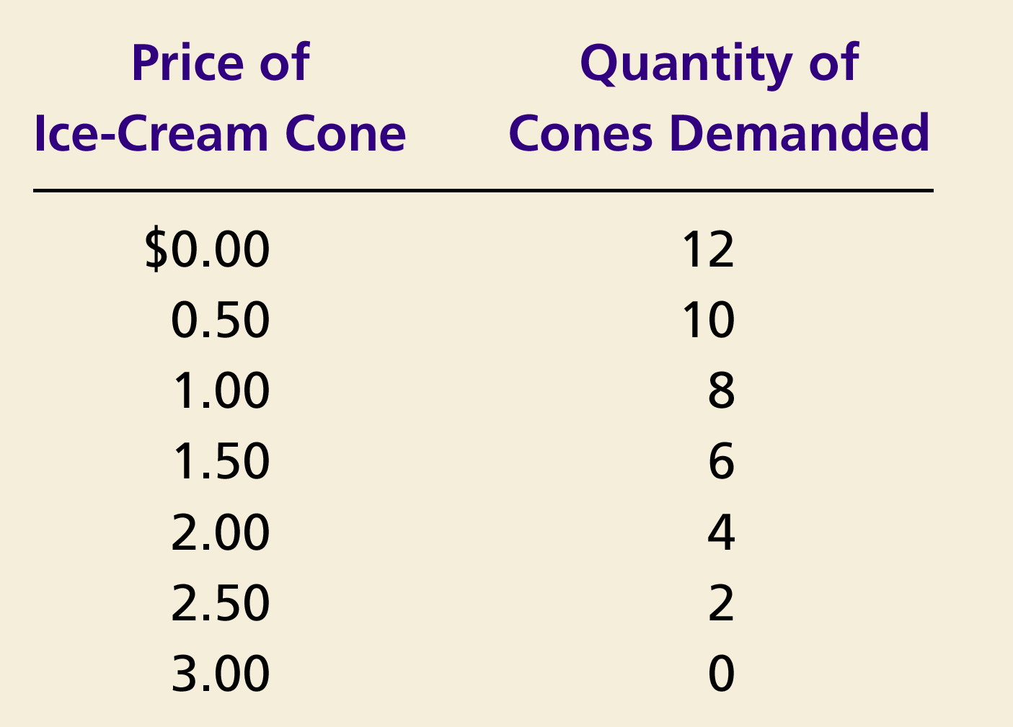

Catherine’s Demand Schedule
Notes:
17

Slide 5

Figure 1 Catherine’s Demand Schedule and Demand Curve
Price of
Ice-Cream Cone
$3.00
2.50
1. A decrease
2.00
in price
...
1.50
1.00
0.50
0
1
2
3
4
5
6
7
8
9
10
11
12
Quantity of
Ice-Cream Cones
2.
...
increases quantity
of cones demanded.
Copyright © 2004 South-Western

Slide 6
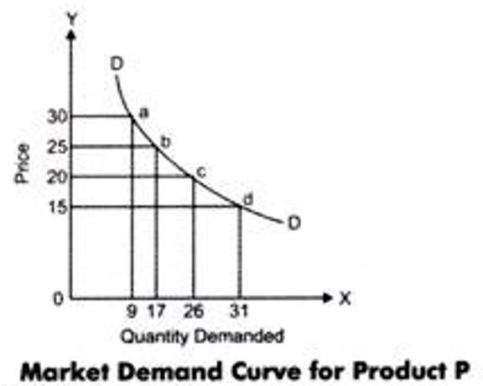
The Demand Schedule/Curve
A demand curve shows the relationship between the quantity demanded of a good and its price when all other influences on consumers’ planned purchases remain the same.
We can also view a demand curve as a willingness-and ability-
to-pay curve. And the willingness and ability to
pay is a measure of marginal benefit.

Slide 7
Changes in Demand Curve
When any factor that influences buying plans other than the price of the good changes, there is a change in demand.
The factors that cause the change are:
1. The prices of related goods: concept of substitutes and complements
substitute is a good that can be used in place of another good. A bus ride is a substitute for a train ride. The quantity of a good that people plan to buy also depends on the prices of its complements. A complement is a good that is used in conjunction with another good. Fish and chips are complements. If price of one goes up, the demand for another will go down and vice versa.

Slide 8
Changes in Demand Curve
2. Expected Future Prices:
This is consumers expectation of future prices of goods and services. You predict/expect that a certain goods price may rise/fall in the future. So purchase it now/later.
So suppose, During Ramadan you expect that price of onions to go up, so you buy it now and store it for that time. Your current demand for onions have gone up but your future demand for onions have decreased.

Slide 9
Changes in Demand Curve
3. Income
Income is a huge factor in influencing your demand for goods and services. Now remember, rise in income leads to rise in demand for most goods and services, but not all goods and services.
A normal good is one for which demand increases as income increases. An inferior good is one for which demand decreases as income increases.
Normal good: good quality of rice (basmati), pasta, LCD and plasma TVs etc
Inferior goods: from canned soup to fresh vegetables, from bus rides to uber rides. Which is one is the inferior good?

Slide 10
Changes in Demand Curve
Expected future income
If you expect a rise in your future income, suppose getting a huge bonus, you may increase your demand for a particular good/service. Or if it falls, you may want to hold on to more of your present income.
Example: Most weddings are seen to occur after company bonuses are given.
During job cuts in 2010 in US, workers were seen to reduce their meals eaten outside.

Slide 11
Changes in Demand Curve
Population Changes
A population comprises of various age, income, geographic structures. Which means different types of goods and services are demanded. A change in the population also changes the type of goods and services that are demanded.
See figure

Slide 12
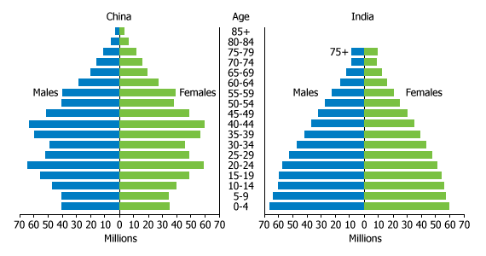

Slide 13
Changes in Demand Curve
6. Preferences
This is your choices or preferences for goods and services. Often some preferences are very unique, in that case we refer to a ‘niche’ market.
Lomé Voodoo Market – a market to buy elephants' feet and leopards' heads
Witches’ Market, La Paz, Bolivia
Ka Firushi Bird market, Kabul, Afghanistan

Slide 14
Changes in Demand Curve v/s Shift in Demand Curve
Any changes in Price (while keeping other things equal) will cause a movement or change along the demand curve. The movement either happens upwards or downwards.
A shift happens when price is no longer our element of concern, other factors (of the 6 mentioned) influence the demand and the demand curve shifts outwards or inwards.

Slide 15
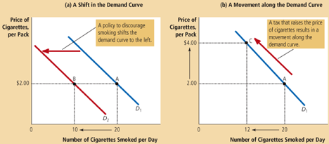
Changes in Demand Curve v/s Shift in Demand Curve

Slide 16
Review Questions
1. Suppose consumers know that during the FIFA World Cup of 2018, TV manufacturers will give discounts as a promotional stunt to attract more customers. As a customer, what would happen to your current demand for TV? And what factor of the 6 mentioned is affecting demanding here?
2. Suppose an unexpected heat wave hits South Asia. Show the effect on the ice market in Bangladesh. What happens to the demand for ice cream in Bangladesh? And what factor of the 6 mentioned is affecting demand here?

Slide 17
Answer
1. Current demand would fall for TVs because customers know that they can get a cheaper price later. The demand for TVs in this case would fall. Meaning the demand curve would shift to the left. Less quantity is demanded at current prices. This is a concept of ‘future expected prices’
2. A heat wave in South Asia, would also affect Bangladesh because it is part of South Asia. Heat wave would increase the demand for ice cream in Bangladesh as well as other South Asian countries. More quantity is demanded at current prices. The demand curve would shift to the right. This is a concept of ‘consumer preferences’

